Slide 1
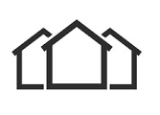
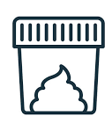

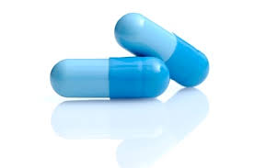

5-6 month intervention
3 rounds; 2-4 days per cluster
= 22 village clusters per site
R1
R2
R3
AMR transmission
Pre-start-during-
Post
Stool collection
Intervention
3M
1M
3M
12 households per cluster;
up to 7 household members
PRE
START
3M
9M
(WATCH) antibiotic use
Pre-/Post patient exit interviews
WASH + Health literacy
Pre-Post
Household-surveys
Patient management
Pre-Post
Simulated patients
Oct’22 – Jan‘23
Apr – June’23
Oct’23 – Jan‘24
Jan – Mar’23
Jul – Sep’23

Slide 2
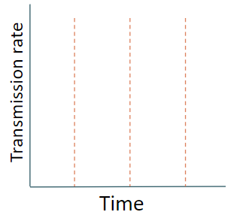
Scenario 1
Scenario 2
Acquisition rate
Acquisition rate

Slide 3
5-6 month intervention
3 rounds; 2-4 days per cluster
= 22 village clusters per site
R1
R2
R3
AMR transmission
Pre-start-during-
Post
Stool collection
Intervention
3M
1M
3M
12 households per cluster;
up to 7 household members*
PRE
START
3M
9M
(WATCH) antibiotic use
Pre-/Post patient exit interviews
WASH + Health literacy
Pre-Post
Household-surveys
Patient management
Pre-Post
Simulated patients
Oct’22 – Jan‘23
Apr – June’23
Oct’23 – Jan‘24
*In DRC slimmed down stool data collection in households as a result of rodent sampling
Jan – Mar’23
Jul – Sep’23

Slide 4
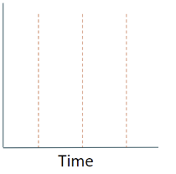
Scenario 1
Scenario 2
Scenario 3
Scenario 4
Scenario 5
Impact on
acquisition
Decolonisation rate
Decolonisation rate
Decolonisation rate
Decolonisation rate
Decolonisation rate
Impact on
decolonisation

